Slide 1
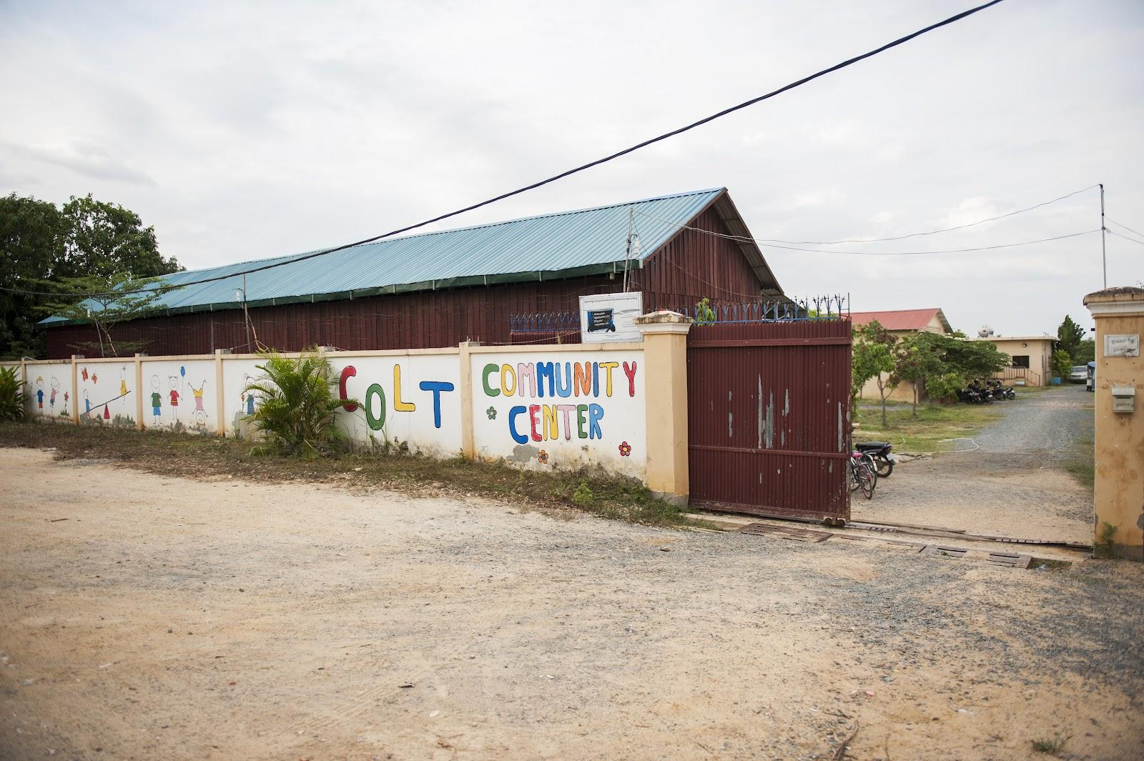
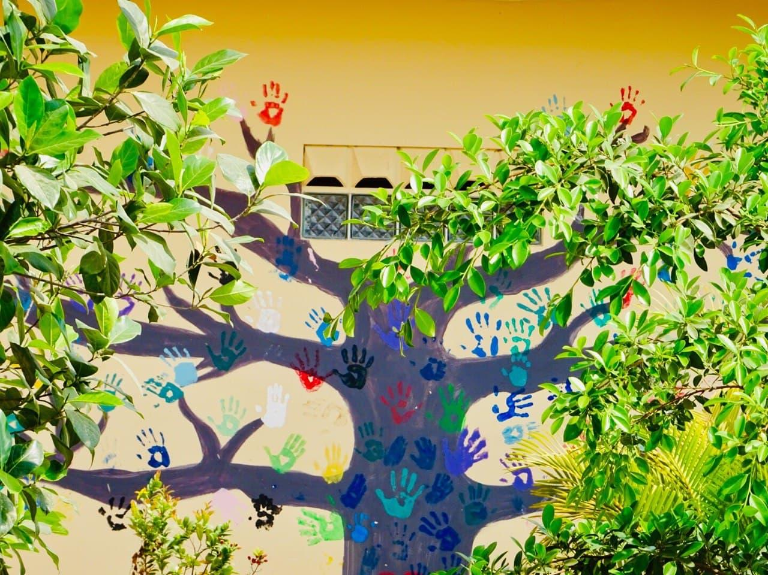
Year report 2022
Cambodian organization for living and temporary care (COLT)

Slide 2
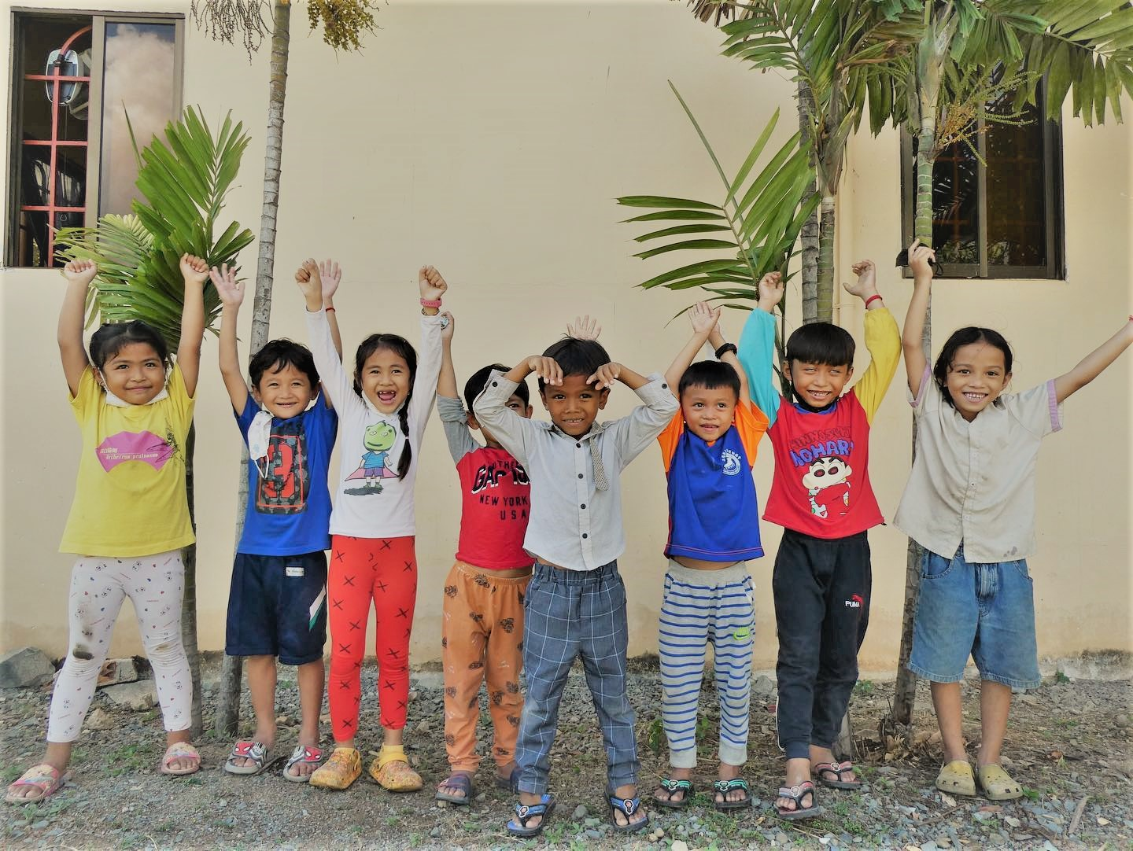
COLT-Cambodia - dutch partner ngo
Voorthuizenstraat 179 2573 AE Den Haag, Nederland
info@colt-cambodia.org www.colt-cambodia.org
coltcommunitycenter
https://www.facebook.com/colt.cambodia
Notes:
Van Veldekekade 12, 5216 KS te Den Bosch

Slide 3
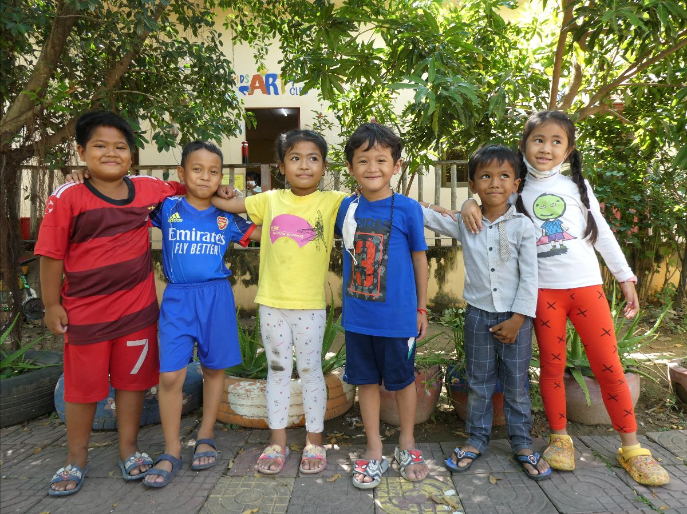
legend
Introduction
Our partners
Governance COLT
Development of our vision
The importance of family-based care
Our impact in 2022
Spring
Summer
Autumn
Winter
fundraising
Thanks!
Contact information
Appendix: Annual Accounts

Slide 4
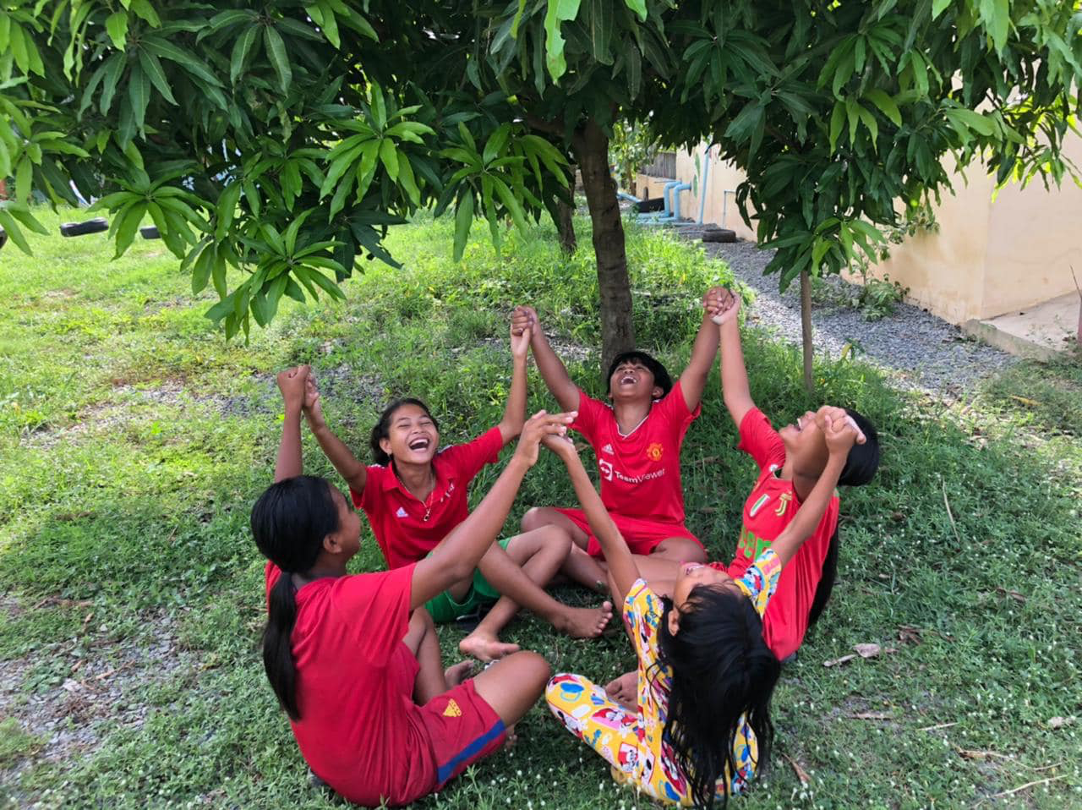
Inleiding
For COLT, the year 2022 was all about (re)starting all activities after the corona pandemic and continuing to work on the new plans for the future. As a result, volunteers and part of the Dutch board were finally able to return to Cambodia after almost three years. We enjoyed it. This year we divide the annual report into four seasons. Click through quickly because this edition contains a lot of visual material including beautiful videos!
Curious about COLT’s history? Click here!

Slide 5
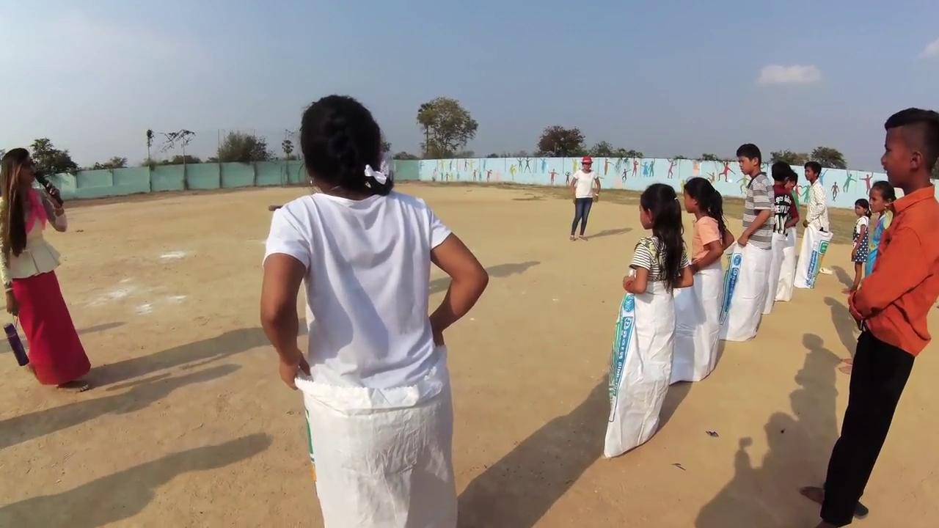
2022: Let’s go!

Slide 6
2. our Partners
COLT strongly believes in the power of collaboration and knowledge sharing. To realize our goals and mission, we work together with local and international partners. With sustainability and empowerment of local communities as key concepts, COLT focuses on strengthening the local and regional network.

Slide 7
3. Governance of colt
Robert Heiduczek
Peter Heiduczek
Helmut Halmich
Deng Dara
Tina Beekman-Tolner
Sam Piseth
Tout Sopheak
Stella Desiree Bosch
Robert Heiduczek
Leng Kongkea
Arnold Hubach
Noach van der Linde
Jessica Michgelsen
Kristine Wittenberg Andersen
Tone Wittenberg
COLT is represented in several countries: Cambodia, the Netherlands, Germany and Norway. All countries have their own local government.

Slide 8
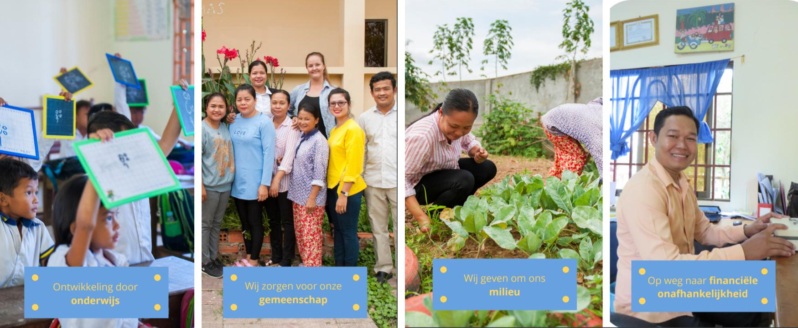
4. On our way to an independent community!
Clickk here to view our strategic vision for 2020-2025.

Slide 9
4. our vision for 2020-2025
In its strategic vision for the period 2020-2025, COLT focuses on four main key themes: empowerment through education, women's and children's rights, the environment and achieving financial independence:
Empowerment through education
We take care of our community
Financial independence
environment
Education has been at the heart of COLT's activities and vision since its inception. In the next 5 years we aim to expand our education capacity without jeopardizing the quality of education.
COLT will intensify partnerships with both local and international NGOs over the next five years, enabling us to deepen our connection with vulnerable groups and increase the number of people we reach.
COLT will continue to invest in sustainable development. Outside the center, the goal is to disseminate important knowledge at the community level so that families understand how their actions affect their immediate environment.
COLT will use the coming years to make the foundation less dependent on international financing. By establishing a local strategic team, reinforced with international expertise, COLT will achieve greater stakeholder engagement from local to national level.

Slide 10
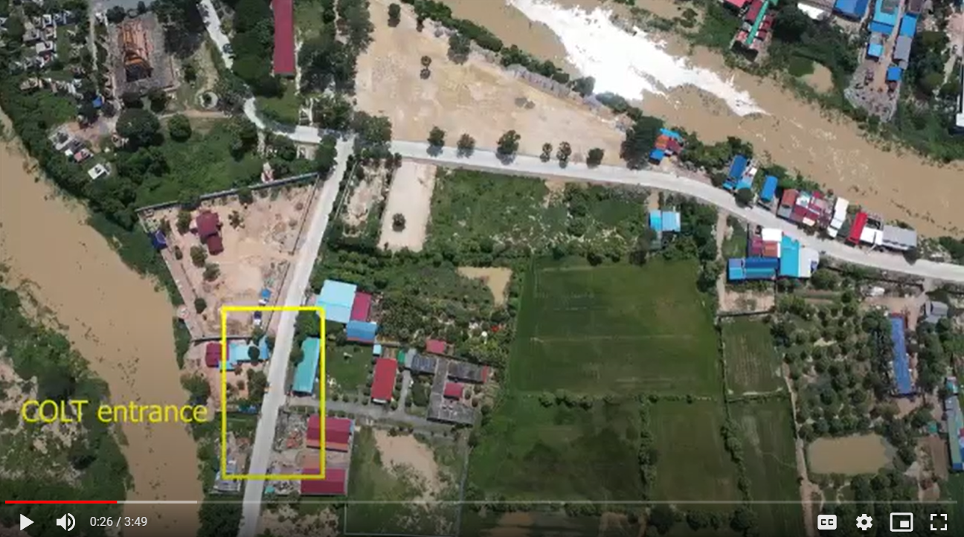
4. Development of our vision 2020-2025
In the period 2015-2020, COLT underwent a transition from childcare to community center, ultimately providing sustainable assistance to children and families in the areas of education, medical and social care, sports and the environment. In order to make this transition successful, various activities are being started up step by step that provide support to various vulnerable groups in the community.
2020
2021
2022
2023
2024
Start vision up to and including 2025
Start from contribution to capacity
Expansion of day care center
Expansion vegetable garden
Start local fundraising and support plan
Local support school & day care according to capacity
Hire local business development and fundraising manager
Further reduction of institutional care
Re-evaluation vision regarding development direct community
Reintegration of the last children from COLT's home
Continued development of Family Based Care
Continued development of prevention through education & day care
Click on the photo for a video about the development of the area between 2015 and 2021, and the plans for the coming years

Slide 11
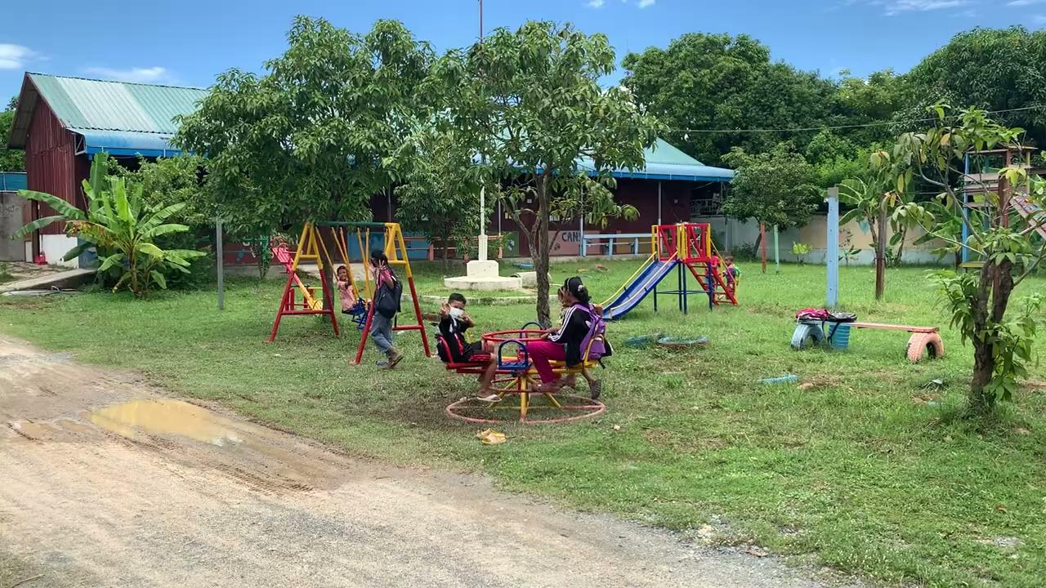

Slide 12
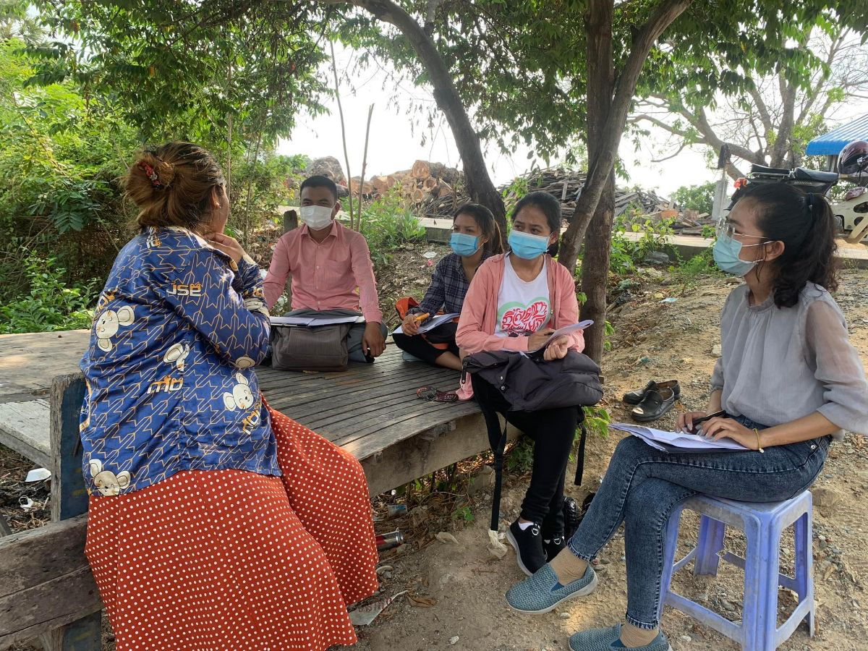
5. The importance o family-based care
Since 2015, COLT has successfully transitioned from shelter to Family Based Care. As a partner of Family Care First (an initiative facilitated by Save the Children and supported by UNICEF) and in collaboration with local authorities, family assessments are frequently carried out. In this, the basic rights of the child are taken as an unshakable starting point. When these family studies show that a (foster) family can guarantee these basic rights, children can be safely reintegrated, while COLT provides ongoing support, for example in the field of psychosocial care, training and mentoring, but also financially.
In line with this transition, we also paid attention to Family-Based Care in 2022. Through Family Power, COLT plays a role in the important step to prevent institutional childcare. Both board members of COLT Netherlands and Piseth contribute to this movement in various ways. In 2022, with the help of Family Power and Wilde Ganzen, we made two professional videos about the importance of family-based care. Have a look at the slides below!

Slide 13
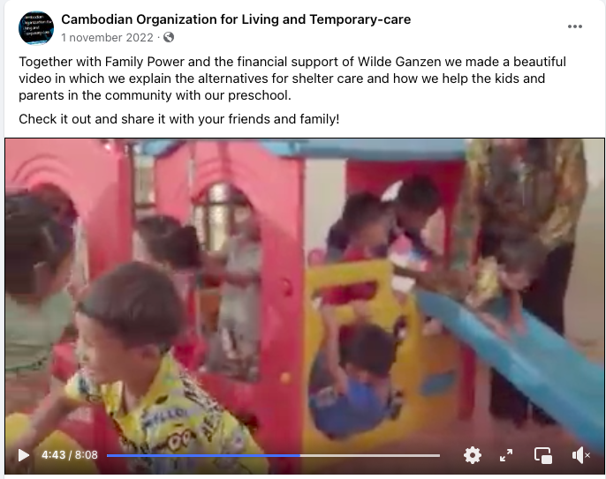
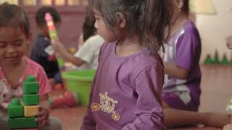
5. Family power
The first video is about the alternatives that COLT offers for institutional care. With our preschool program and daycare, we welcome dozens of children to our site every day, while they can live and grow up with their families.
With the nannies taking care of children all day long, from hygienic care to learning through play and from an afternoon nap to a nutritious meal, you can see the power of COLT in the video: care in your own family, but with alternative options during the day at our preschool or daycare.
In this way, both parents can build a life, work full-time and thus create a safe situation for the child.

Slide 14
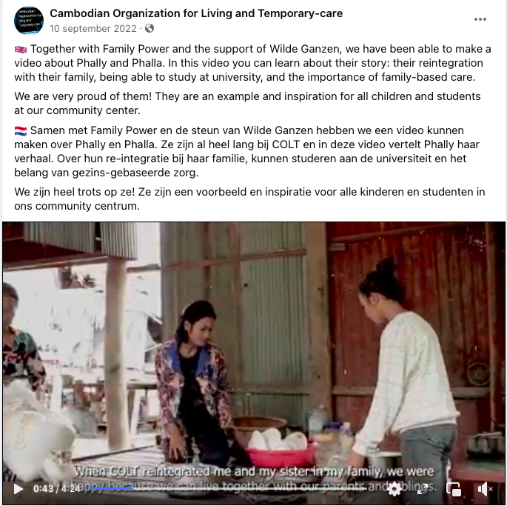
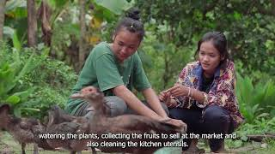
5. Family power
The second video is about Phally and Phalla. After they were reintegrated into their family, COLT continued to be an important conversation partner.
The sisters live with their mother again and COLT maintains local contacts and supports further development by paying study costs. They are a textbook example of how to successfully complete the reintegration of children, with a program where we do not lose sight of the children once they have left COLT.
We are confident that we can achieve this for all children in long-term care!

Slide 15
6. COLT’s impact in 2022
Program | Short term impact in 2022 | Long term impact
Day care | 36 children from 2-6 years old stayed during workdays in a safe day care place which included good care and two healthy meals. They also learned a lot of basic English and Khmer language while their mothers (n=34) could go to work to generate extra income to improve their living situation. The parents also participated in capacity building trainings four times in 2022. | With the care at COLT daycare, the children grow well in terms of physical health, intellectual potential and many positive daily routines. They learn good habits like loving school and ready to be in a classroom when they are 6 years old. They will be able to find their potential and work hard to achieve their dream when they grow up. So, their next generation will be better and better. The family living condition improves more and more so parents will also fulfill a role model in the community. With the knowledge they received from the training at COLT the parents are better able to maintain a good lifestyle and never fall back to the poorness again. Hence the parents will also be able to give a positive example and advice for their children.
Preschool | While the children go to state school for half day in the morning, 20 students who were 6, 7 or 8 years old stayed and studied in the afternoon in the safe COLT preschool. At the same time, their parents can go to work together to improve the living condition. COLT also provided school uniforms and study materials once a year. 18 parents joined the parent capacity building trainings (4x per year). | The students will not drop out school as they are good students from double learning at COLT preschool. The children will have good knowledge in Khmer literature, Math and English language. The parents have knowledge in positive parenting skill and other skills like money management, so they will be able to support their own children for a higher education.
School | 125 students had English class at COLT for a half day in the afternoon this year. They also received school uniforms and study material of a complete for a year from COLT. | English is an important second language in Cambodia as many workplaces require English. So, when they know English from COLT for a certain level, they will be able to do self-learning and continue to the next levels at another school without a too late of a start. With the English language that the students start learning at COLT, they will be able to use it at work and do research for their better living purpose.

Slide 16
6. COLT’s impact in 2022
Program | Short term impact in 2022 | Long term impact
Home-based care | 4 kids got supports from COLT directly, 5 kids received home-based care indirectly and 7 adults received our service indirectly. COLT provided rice for living, education costs, rent room fee and pocket money to ensure the kids can live with family and still can go to school without separation. | They children will grow well with their families without separation even though they are poor. With the support from COLT, the direct and indirect children in the family will be able to gain knowledge and or skills to help their families to leave the poverty cycle.
Sports | 64 kids joined the football program. They received all the football ware like football uniforms, football shoes, and ball for practice. They were busy with football everyday. | The students were busy playing football all the time, so they didn’t have time to do bad things like using drug and being gang. They gain a lot of important skills from football like running, being tactical, being more socialized, having good health and have a lot of friends. These are the motivations for them to work harder at school as well as in their life, they learn to accept win and failure. So, they are to be ready for growing up as a good citizen in Cambodia.
Life skill workshops + awareness | 115 students joined the workshop for 7 times a year. They learned about hygiene, women’s health, reproductive health, children’s rights, environment, teamwork and leadership skills. | With all these skills the children will be able to take care of themselves and people around them and love the clean environment. They will become role models in the community and create a good community for themselves. When they live in a good community, they will have a good life.
Creative skill development | 65 students joined creative skill + critical thinking workshops four times a year. The learned and practiced critical thinking. | The students will be able to think critically about certain societal matters. Also, they will be able to analyze what should be and what should not be so that they will not fall in any wrongdoings.

Slide 17
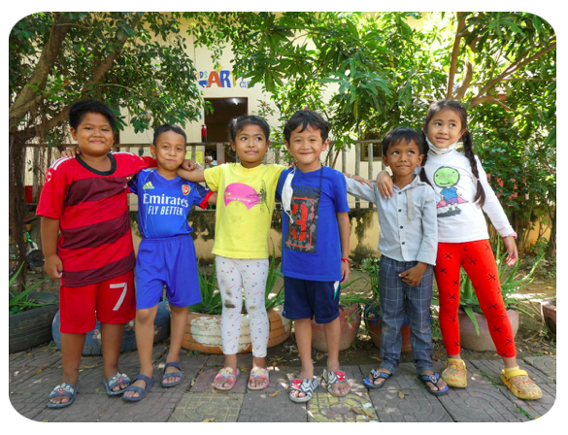
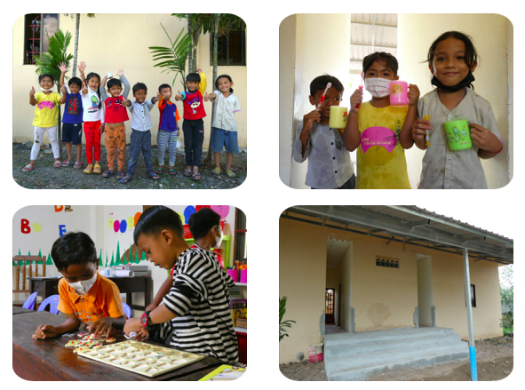
7. spring
New Preschool Program
After countless hours of hard work and a good dose of patience due to the pandemic, we couldn’t be more excited to announce that we have finally opened a new preschool program! An empty bedroom has been converted into a fun and colorful classroom for our youngest students, with its own entrance and bathroom. The class is a combination of the daycare and preschool class we already have: the students come in the afternoon after studying at public school, and they stay for up to four hours. While they’re here, they learn English, Khmer and math. Daily hygiene practices like toothbrushing and hand washing are also implemented, and some of the students eat lunch at COLT.
A Big Milestone!
The new school year started in January, and with that six of our daycare children moved on to COLT’s preschool program and first grade at public school. After spending 2-3 years in our daycare they have learned important social, motor and early learning skills which will benefit them greatly. We will continue to work closely with their families, encourage them and support them in various ways to keep them in school.

Slide 18
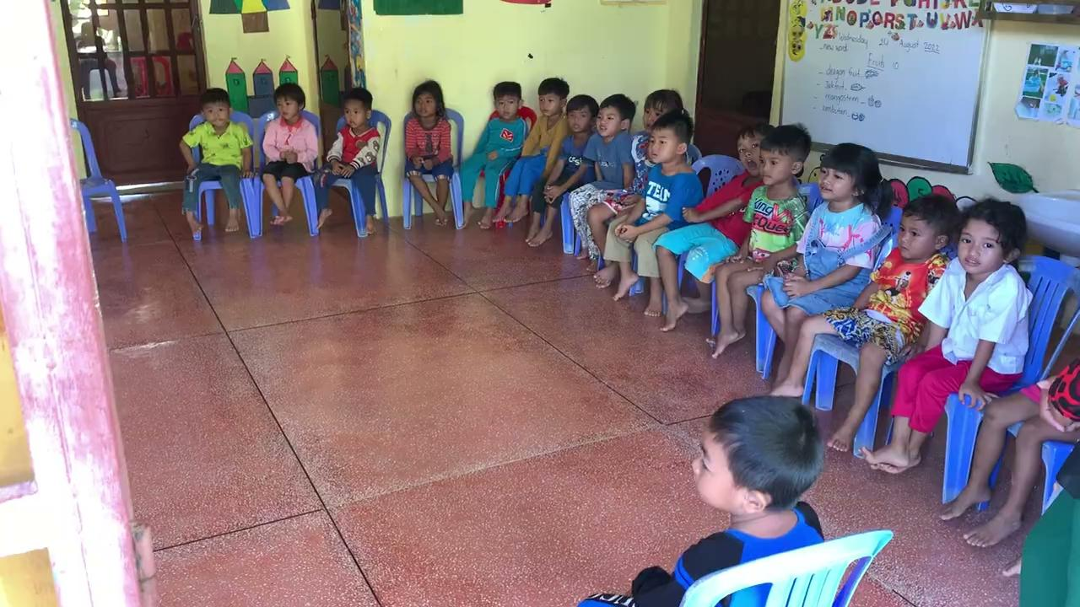
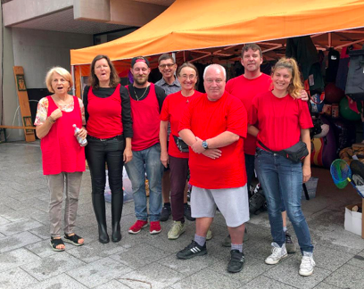
8. summer
Thank you so much, Sabina!
Sabina Baire says good bye after ten years of being a Dutch Board Member. We would like to thank Sabina very much for all her efforts, energy, enthusiasm, and sometimes a critical note. We talked a lot about COLT’s future together; thank you for all your input in this.
Click on the video above to see the day care!
A succesfull fleamarket in Germany
COLT Germany is very happy as they could once again do their annual fleamarket to raise funds for COLT-Cambodia. After a week of preparations, they sold many things on the first weekend of July!

Slide 19
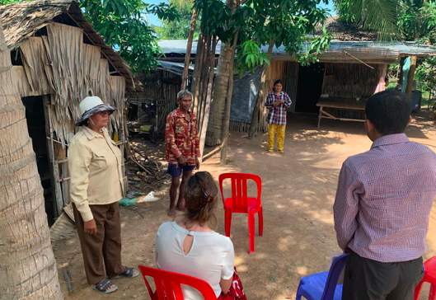
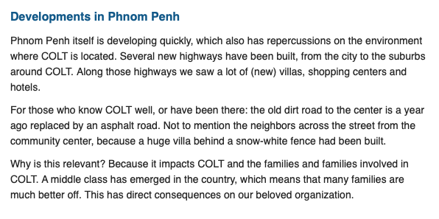
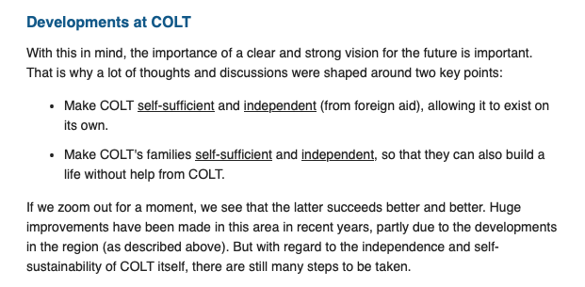
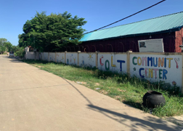
9. herfst

Slide 20
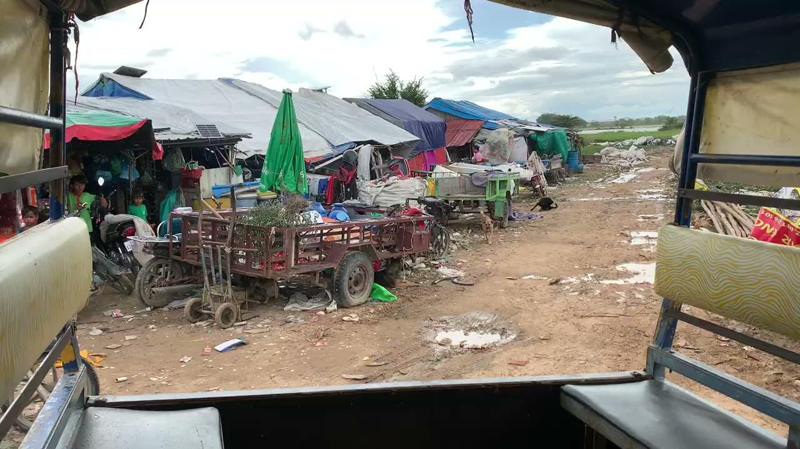

Slide 21
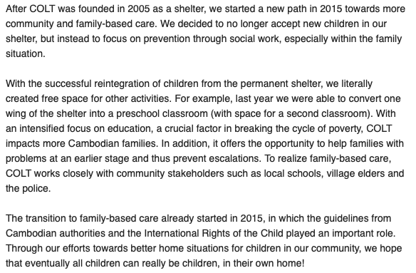
10. winter

Slide 22
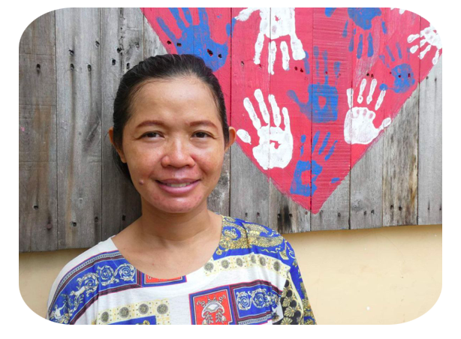
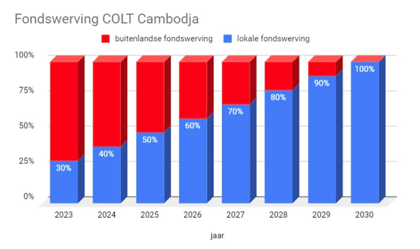
11. Fundraising: for & by cambodia
In line with COLT's long-term vision, the empowerment of the local population is high on the list of priorities. All stakeholders in COLT's organization ultimately have the goal that both the center and the community it supports become increasingly self-sufficient. Mobilizing local support and fundraising is an important part of this development.

Slide 23
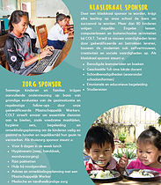
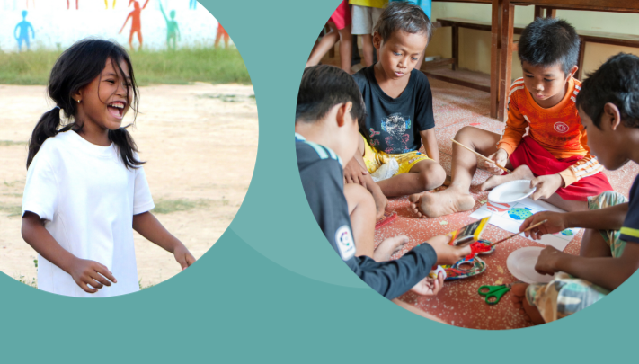
11. Sponsor packages
We are proud of our sponsor packages!
COLT is proud to present our new sponsorship packages with you. The program is based on the Strategic Vision and offers the opportunity to support us in various ways. As a monthly sponsor you can support us on the following topics:
Classroom
Home care
Sport
Green
Daycare
Reintegration
Daily business
Running a community center has all kinds of challenges: education, family care, gardening, flood prevention, but also food for the children in the (day) care and of course other basic needs: electricity, water supply and maintenance. As a monthly sponsor, you help us overcome these challenges.
Klik HIER om de sponsorpakketten te bekijken en je aan te melden!

Slide 24
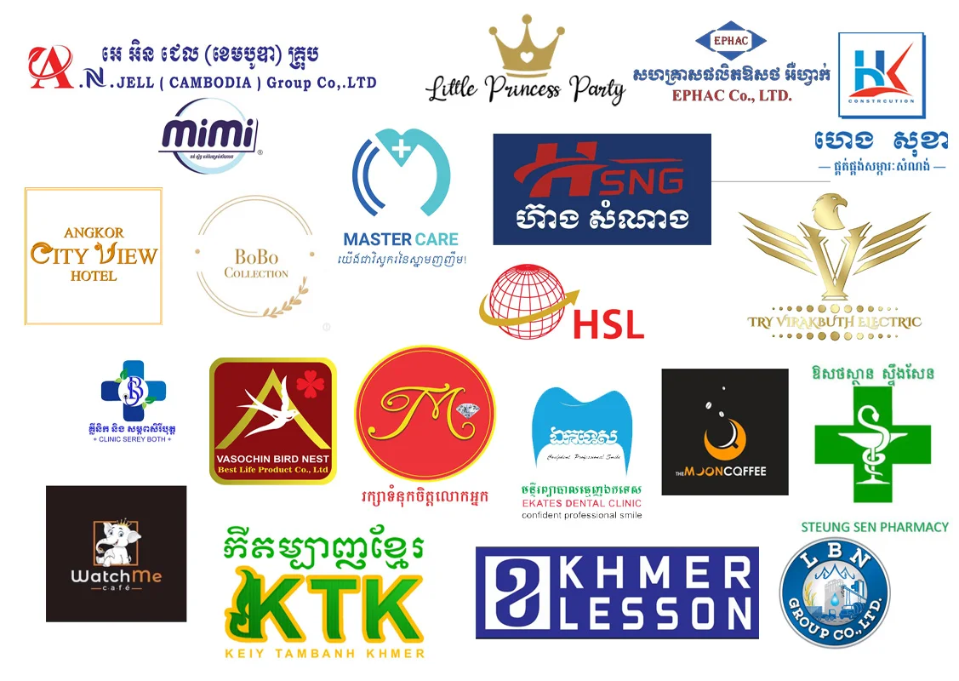
12. Thank you!
Finally, we would like to express our gratitude to all donors and sponsors, in particular Haella Foundation and Wilde Ganzen who helped us realize two specific projects (namely home-based care, the awareness campaign and bridge-the-gap programs) .
In addition, special thanks also go to the permanent members of the Club of 100, which was expanded in 2022 with a large number of Cambodian members!

Slide 25
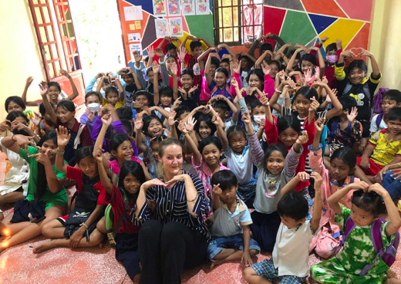
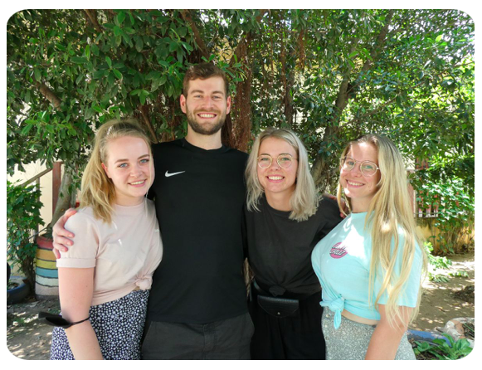
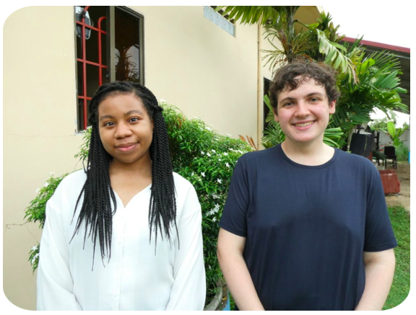
12. Dank!
Thanks to John ter Horst (Windesheim Zwolle) for the great cooperation in recent years!
Kristine, a big big big thank you to you for working at COLT as a coordinator for more than 7 years!

Slide 26
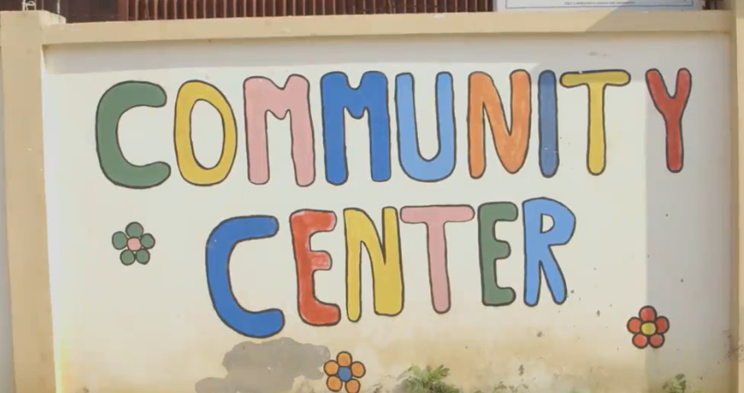
13. Contact informatie
Address COLT-Cambodja:
#301, St. Tumnop Prek Thnot Sangkat Dankor, Khan Dankor Phnom Penh, Cambodia
Tel: 855-23-6320028
Bank:
Rekeningnummer COLT-Cambodia
IBAN: NL81RABO0120024942
BIC: RABONL2U
KvK.nr: 02092710
ANBI.nr: 70433
Email-addresses:
Algemeen: info@colt-cambodia.org
Arnold Hubach:: arnold@colt-cambodia.org
Noach van der Linde: noach@colt-cambodia.org
Jessica Michgelsen: jessica@colt-cambodia.org

Slide 27
14. Appendix: Balance over 2022 compared to 2021
Omschrijving | 31 december 2022 | 31 december 2021
Activa
Financial fixed assets
Other receivables | 1 | 1
Current assets
Liquid assets | 53.460 | 78.100
Total asset side | 53.461 | 71.101

Slide 28
14. Appendix: Balance over 2022 compared to 2021
Omschrijving | 31 december 2022 | 31 december 2021
Passiva
Foundation assets
Free reserve | 52.661 | 77.301
Current liabilities
Accountant fees | 800 | 800
Total liabilities side | 53.461 | 78.101

Slide 29
14. Appendix: Statement of Income and Expenditure
Omschrijving | 2022 | 2021
Benefits | 40.113 | 50.565
Total revenues | 40.113 | 50.565
Inventory and machine costs | 64.773 | 44.750
Office expenses | 218 | 228
Overheads | 945 | 912
Sum of operating costs | 65.936 | 45.890
Operating result | -25.823 | 4.675
Interest income and similar income | 1.986 | 908
Interest and similar expenses | -805 | -643
Sum of financial income and expenses | 1.181 | 265
Result | -24.642 | 4.940

